Slide 1
The Victorian Era: Fashion
By: Kendall Warf

Slide 2
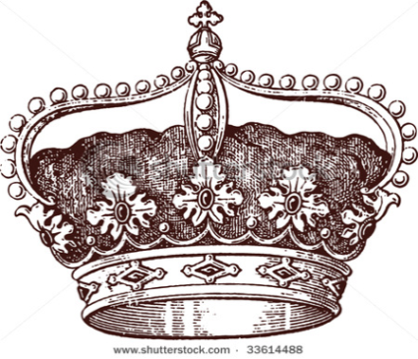
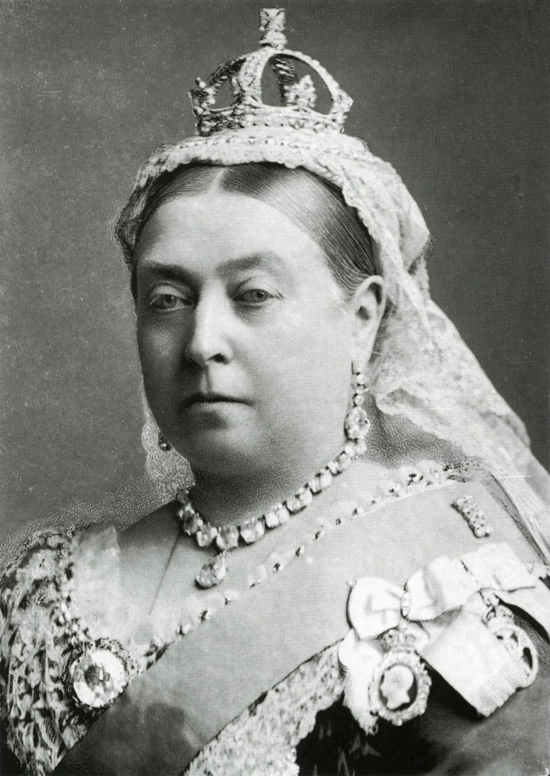
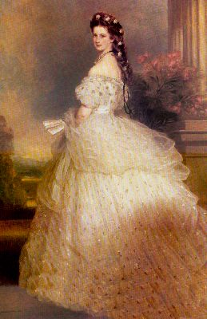
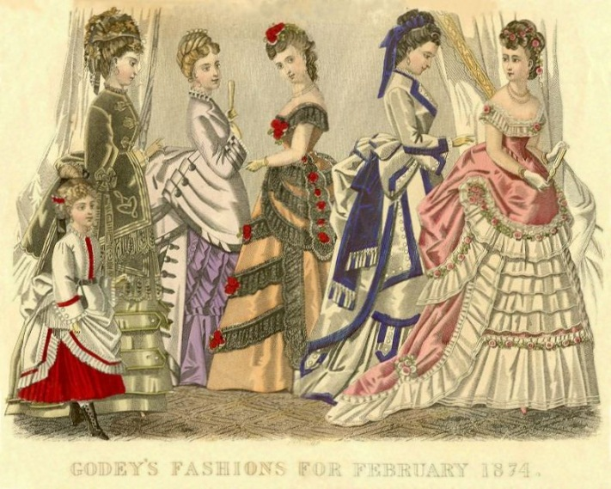
The Victorian Era:
The Victorian Era was a time where a powerful woman named Victoria ruled for several decades dominating the political world.
The era was divided into two parts: the early, which is from 1830-1870 and the late, from 1870-1990.

Slide 3
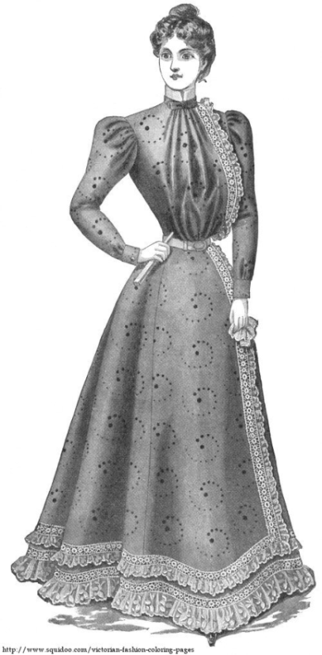
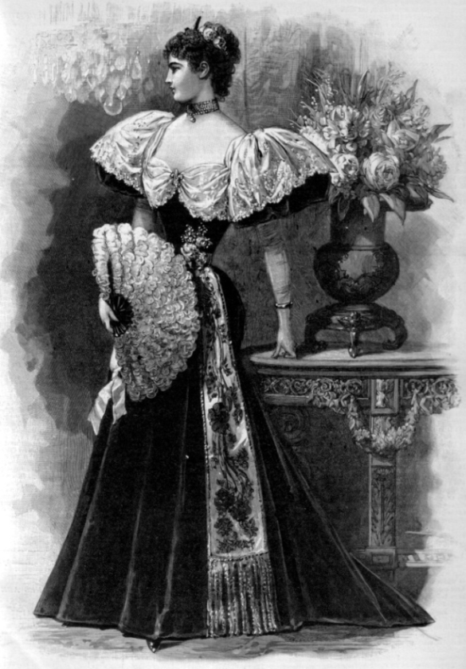
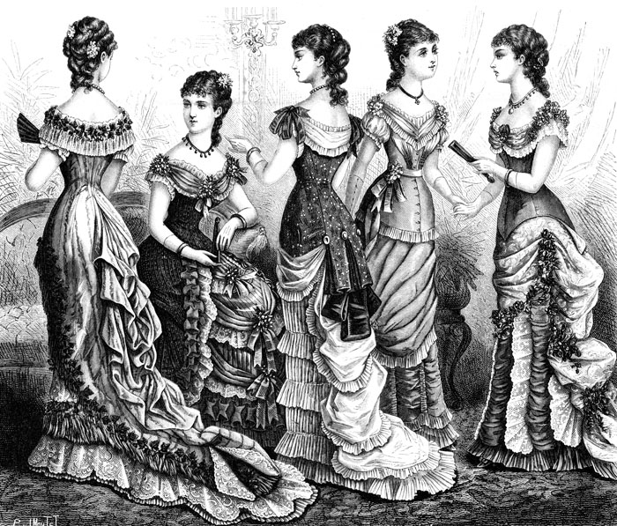
Dresses:
F
A
S
H
I
O
N
During this time period women had
a magnificent wardrobe full of
spectacular gowns which included:
lounge gowns
walking out dresses
evening or ballroom gowns

Slide 4
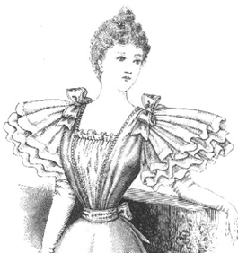
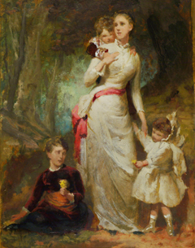
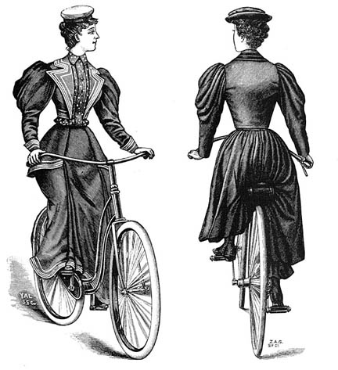
F
A
S
H
I
O
N
The Lounge Gown:
The lounge gown was worn by the woman “at home.”
The dress was made in velvet and lace with an overdress of cashmere.
There were also bows on the shoulders of the dress.

Slide 5
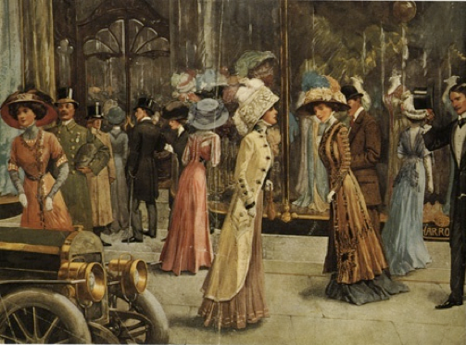
Day Dress:
F
A
S
H
I
O
N
Another dress a Victorian woman would be
seen in was
A day dress, also called a
“walking out” dress.
It consisted of a V-neckline filled with a high ruffle collar.

Slide 6
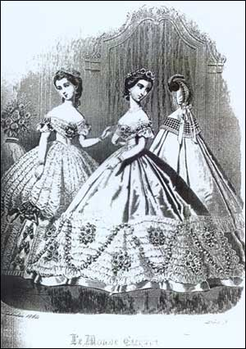
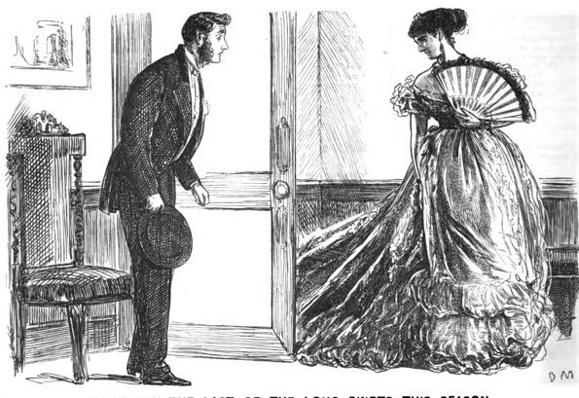
Wealthy women were often seen
wearing an evening gown or a
ballroom gown.
The gown was worn to special
events.
The gown sported a low
shoulder bodice edged
with frill.
It also had a sleeve
that hit the elbow and
ended with a ruffle.
Ballroom Gown:
F
A
S
H
I
O
N

Slide 7
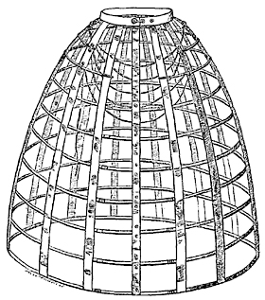
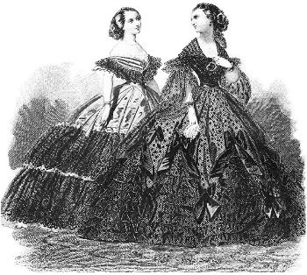
F
A
S
H
I
O
N
The Crinoline:
The invention of the crinoline changed the shape of the Victorian woman.
A crinoline was a light dress frame made from steel hoops.
Up to 35 steel springs increased in diameter as they reached the ground.
DANGER! DANGER!
During the 1860’s one woman's crinoline caught on fire: she and 2,000 others died from the accident inside the Cathedral.

Slide 8
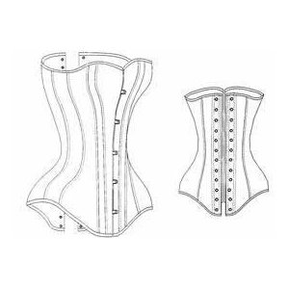
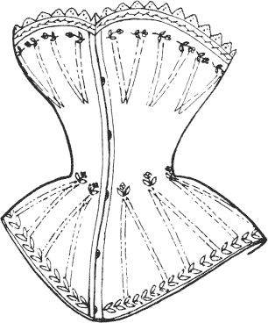
The Corset:
F
A
S
H
I
O
N
The corset gave a woman a conical form while lifting and supporting the bosom.
It also minimized the waist by producing a curved hour-glass shape.
A corset often laced up the center of the back to achieve tightness. However, there were hooks in the center of the torso to allow easier removal.
Corsets were worn over a cotton chemise, not directly over the skin.

Slide 9
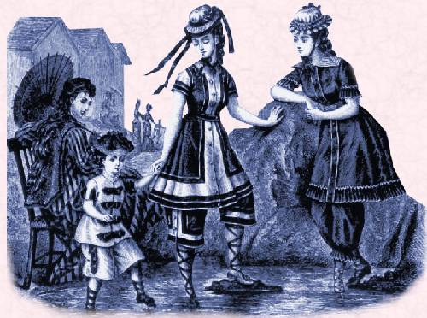
T
H
E
F
A
S
H
I
O
N
B
A
T
H
I
N
G
S
U
I
T
During the Victorian Era bathing suits covered most of the female figure.
The pants were “Turkish” style while the dresses worn over them were made from a heavy flannel fabric; the fabric quickly became water-logged and weighed down the swimmer.
Women typically dressed in black knee-length, puffed-sleeved wool dresses worn over bloomers and trimmed with ribbon and bows.

Slide 10
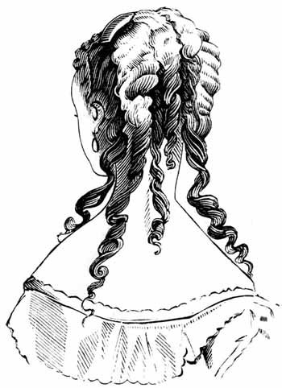
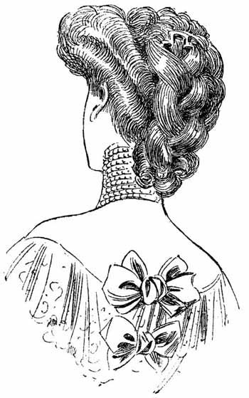
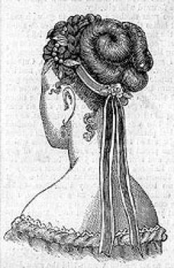
F
A
S
H
I
O
N
Hair:
During the early Victorian period hair was generally worn long or caught up in a bun.
By the 1840's, ringlets of curls hung on either side of the head.
In the 1870's, women drew up the side hair but let it hang in long, loose curls in back. Crimping also became popular in the early 1870's.
Throughout the Victorian period, women wore false hair pieces and extensions, as well as artificial flowers.
Wealthy women boasted encrusted head pieces with diamonds and pearls.

Slide 11
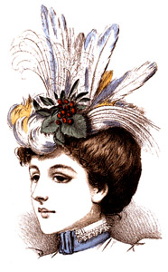
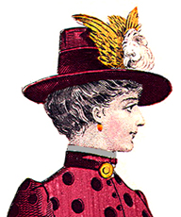
F
A
S
H
I
O
N
HATS!
Women during this time were known from their hats.
Women would often use birds to decorate the inside and outside of the hat.
In some cases the entire bird would be used to decorate the hat.

Slide 12
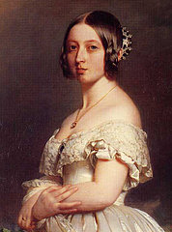
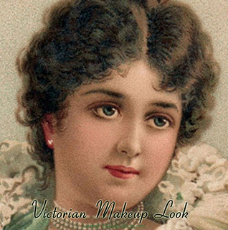
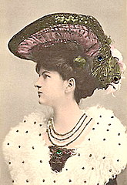
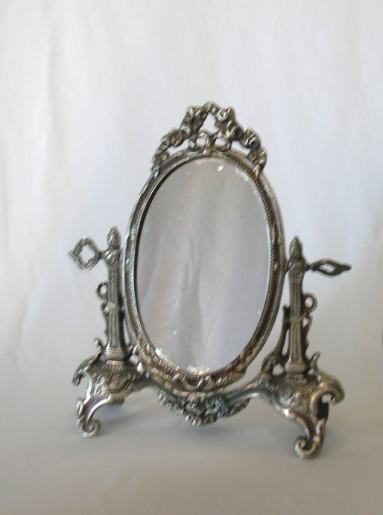
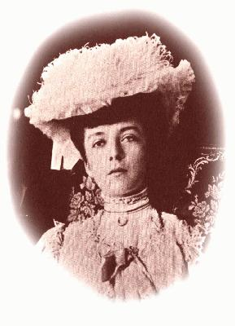
F
A
S
H
I
O
N
Make- Up
Make up was mostly
worn by theater people.
Women in Victorian days
were often very pale;
Occasionally they dared to
wear a smidgen of rouge on
the cheeks.

Slide 13
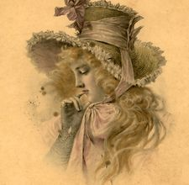
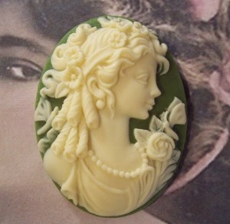
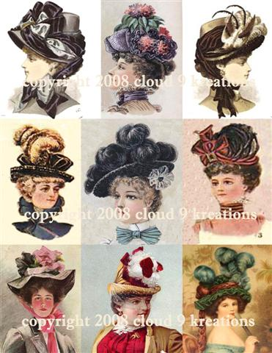
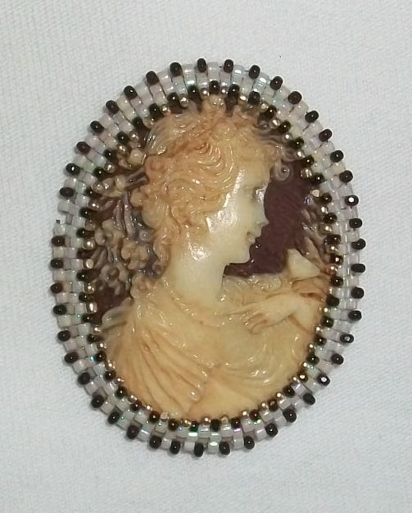
THE
END

